Slide 1
Update on the Opioid Crisis in Alberta First Nations - Focus on Naloxone
First Nations and Inuit Health Branch-Alberta Region, May 2018

Slide 2
Objectives
Increase understanding of the impact of the opioid crisis on reserve in Alberta
Review how opioid overdose prevention is being supported through Alberta Health Services Community Based Naloxone Program
Discuss common questions related to overdose prevention, including the role of Intranasal Naloxone
Discuss the provincial Indigenous Grants and how they will support the community response to the opioid crisis

Slide 3
Public Health Surveillance

Slide 4
Key points from public health surveillance
The number of opioid overdose deaths in Alberta is increasing
On average,1.9 individuals in Alberta die every day due to opioid poisoning
The majority of opioid overdose deaths involve fentanyl
Carfentanil is being found more frequently as a cause of overdose death. Overdose deaths related to carfentanil have increased from 30 deaths in 2016 to 159 deaths in 2017, a 430% increase

Slide 5
Key points from public health surveillance

Slide 6
First Nations public health surveillance

Slide 7
Key points from First Nations public health surveillance
First Nations have a rate of opioid drug toxicity deaths three times higher than non-First Nations
There are lower rates of fentanyl related deaths among First Nations and higher rates of overdose related to codeine, benzodiazepines and alcohol
For First Nations, males and females are equally represented as compared to non-First Nations where males have a higher representation
The rate of opioid dispensing to First Nations in Alberta is approximately two times higher than non-First Nations. Within 30 days before death, the rate of opioid dispensing was also higher among First Nations.

Slide 8
Key points from First Nations public health surveillance

Slide 9
What we are hearing from communities
Concerns about Fentanyl, Carfentanil and W-18 are widespread in communities
There have been confirmed on-reserve fentanyl overdose death clusters in a few communities
Substance use is mixed and variable- alcohol, stimulants, prescribed codeine, marijuana
Use is episodic, binge patterns common
Many communities are increasing their Opioid and Harm Reduction programming
Many communities are experiencing a complex and long standing social and health crisis of which overdose is the latest symptom
Lack of access to health services, stigma and racism are prevalent

Slide 10
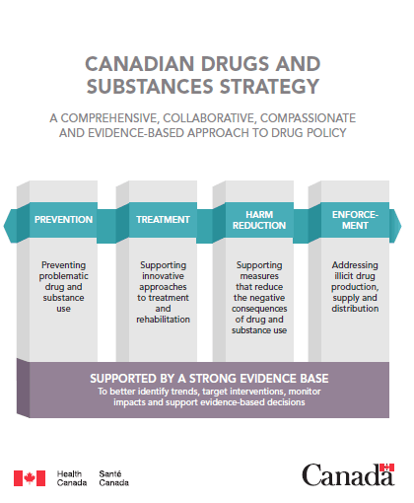
Government of Canada Opioid Crisis Response
On February 17, 2017, the Government of Canada announced $65M over five years to support the federal response to the opioid crisis and to implement the government’s Opioid Action Plan.
On March 10, 2017, the Government of Canada announced an additional $6M in urgent support to the Province of Alberta to assist with their response to the growing effects of the opioid crisis in the Province.
A key component of the national response to the opioid crisis is the development of community-led, culturally relevant, sustainable response based on the four pillars of:
Prevention
Treatment
Harm Reduction
Enforcement
These pillars are all informed by an evidence-based approach
Notes:
FNIHB-AB efforts to address the opioid public health emergency fall under existing action plans, horizontal initiatives and frameworks developed with First Nations partners. This includes the government-wide pillars of the Canadian Drugs and Substances Strategy which is based on four pillars; prevention, treatment, harm reduction and enforcement all supported by a strong evidence base. FNIHB-AB’s response has also been informed by the First Nations Mental Wellness Continuum Framework and Honouring our Strengths: a Renewed Framework to Address First Nations Mental Wellness Continuum Framework. This four-pillar approach, complimenting strategies developed by First Nations and provincial partners, has guided the response to problematic drug use in First Nations communities.

Slide 11
Provincial Response to the Opioid Crisis
The provincial response is coordinated by the Minister’s Opioid Emergency Response Commission (MOERC)
$30 million in funding has been provided to support this
$5 million is targeted Indigenous funding
Saving lives continues to be the priority. This is initially supported through overdose awareness and prevention
Improving access to medical treatment of opioid dependency has also been a focus
Harm reduction interventions have been increased in AHS and in non-profit organizations

Slide 12
FNIHB Alberta Response
Support for communities in crisis
E.g. recent upswing in overdoses Blood Tribe
Support Harm Reduction interventions
Community based Suboxone treatment
Take Home Naloxone distribution
Support for interventions along the Mental Wellness Continuum
Contribute to province wide response through participation in MOERC, telehealth and naloxone distribution
Non-Insured Health Benefit Program - multiple roles including Intranasal Naloxone funding and supporting transportation to treatment

Slide 13
AHS Community Based Naloxone Program
Amy Woroniuk, Harm Reduction Director, AHS
see separate presentation

Slide 14
Intranasal Naloxone
Notes:
Jacqueline Ming, Regional Pharmacist, FNIHB
https://www.pharmacists.ca/news-events/news/how-to-use-naloxone-nasal-spray-in-a-few-simple-steps-new-video-and-infographic/

Slide 15
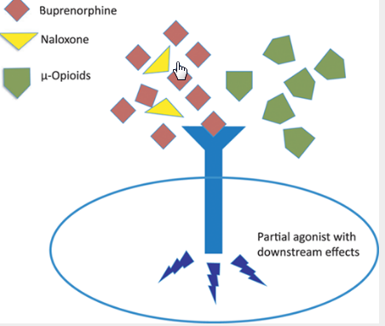
Naloxone Mechanism of Action
http://anesthesiology.pubs.asahq.org/article.aspx?articleid=1917779
Notes:
Opioids bind to opioid (mu) receptors and this creates a signal to the brain (and other parts of the body) to create effects on the body, such as nausea, vomiting, drowsiness, constipation, and pain relief. At higher doses, opioids may induce euphoria, or a sense of “feeling high”; however, at high enough doses, someone may start to lose consciousness, have slowed breathing and even stop breathing, which can be deadly.

Slide 16
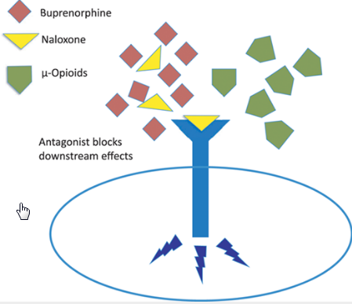
Naloxone Mechanism of Action
http://anesthesiology.pubs.asahq.org/article.aspx?articleid=1917779
Notes:
Naloxone competes with opioids at the opioid receptors and when naloxone binds to the receptors it stops the signal from causing all the effects from opioids. Therefore, it should reverse the lethal effects of respiratory depression (or arrested breathing) and loss of consciousness.
Naloxone only works on opioid overdoses.
Naloxone will not cause harm to someone who does not have opioids in their system. However, it should be noted that someone who has opioids in their system and is administered naloxone, may go into withdrawal. S/he may be very aggressive upon awakening and may want to use opioids again to combat the withdrawal symptoms.
The duration of effect of naloxone is around 30 minutes whereas the average duration of effect of opioid (depending on the chemical) is around 4-6 hours. Therefore, it is important to seek help, even after the overdosed person has regained consciousness.

Slide 17
Naloxone Intranasal Spray
Effective March 27, Narcan nasal spray is an open benefit for clients of the NIHB Program.
Narcan nasal spray has been added to NIHB’s Pharmacist-Initiated Treatment Policy
It may be requested for client’s personal use, or to protect an at-risk person.
Where pharmacies are providing ancillary supplies to support safe nasal naloxone administration and overdose management, providers can bill the cost of the naloxone and ancillary supplies as a naloxone nasal spray kit Accepted contents for reimbursement in a naloxone nasal spray kit include:
2 x 4 mg naloxone nasal spray devices
1 rescue breathing mask
1 pair of gloves
Carrying case
Notes:
The client requesting naloxone does not have to specify who it is for; however, it must be billed to the NIHB Program under the name of the eligible client who is requesting it (even if it is not for their personal use).

Slide 18
Indigenous Opioid Response Grants
Lara McClelland, Executive Director, Strategic Policy and Indigenous Health Branch, Alberta Health
Trish Merrithew-Mercredi, Executive Director, First Nations Relations
On behalf of Indigenous Advisory Committee, MOERC

Slide 19
Indigenous Opioid Response Grants
In Fall 2017, Associate Minister of Health Brandy Payne accepted a recommendation from the Minister’s Opioid Emergency Response Commission to provide $3 million – later increased to $5 million – to Indigenous communities to address the opioid crisis in their communities.
The Indigenous Opioid Advisory Sub-Committee (IOAC), established by Indigenous Relations, provided guidance on the allocation of grant funding to support Indigenous peoples in Alberta respond to the opioid crisis. The Committee convened on October 25, November 1, January 15, and February 6.
Alberta Health and the Government of Alberta have committed to the principles of the United Nations Declaration on the Rights of Indigenous Peoples and the Truth and Reconciliation Commission Calls to Action, and have embarked on new ways of working with First Nation and Metis communities, focusing on relationships.

Slide 20
Indigenous Opioid Response Grants
Following lead of the Minister of Health, the Indigenous Health Unit (Alberta Health) has developed an approach of engaging with Regional Indigenous Organizations, specifically working with Health Directors or Health Boards to identify culturally appropriate process and protocols to establish collaborative relationships at the Treaty, Tribal Council and Nation levels, as well as with MNA and MSGC, also including partnerships with AHS and other key stakeholders, to address health priorities.
The team worked with the Metis Nation of Alberta, Metis Settlements General Council, Confederacy of Treaty 6, Treaty 8 First Nations of Alberta, Blackfoot Confederacy and Stoney Nakoda Tsuut’ina Tribal Council.
The outcome:
15 Community Based Proposals that emphasized naloxone training and distribution, enhanced culturally appropriate awareness and education on opioids use / misuse and treatment options, and culturally appropriate training for front line service providers.
5 Provincial Based Proposals that emphasized culturally appropriate navigation pathways and connections to harm reduction agencies, Friendship centres and stronger coordination of opioids related services and discharges from Emergency Departments in Grande Prairie, Edmonton, Calgary and Lethbridge.
High level examples of proposals:
Community Engagement Awareness & Education Sessions & Communications, Cultural Safety Training , Harm Reduction, Service Provider, Law Enforcement and Mental Health & Addictions Partnerships, Capacity Development, Crisis Response Planning, Youth and Elder Programming, and Indigenous World View & Land Based Teaching

Slide 21
Frequently Asked Questions
Overprescribing physicians- What is being done and is it working?
Have there been deaths associated with administering naloxone and not calling 911
What are the risks to staff from skin absorption for Fentanyl and other synthetic opioids?
What is the FNIHB policy on Intra Nasal Naloxone?
What about Suboxone? Will it work for people who use codeine for chronic pain?
Notes:
For Question 1:
NIHB also provides provider engagement (eg. ID high prescribers, inform prescribers of high usage to try to bring volume/dosing down). Not sure how well it is working.
For Question 3:
CDC: Potential exposure routes of greatest concern include inhalation, mucous membrane contact, ingestion, and percutaneous exposure (e.g., needlestick). Any of these exposure routes can potentially result in a variety of symptoms that can include the rapid onset of life-threatening respiratory depression. Skin contact is also a potential exposure route, but is not likely to lead to overdose unless large volumes of highly concentrated powder are encountered over an extended period of time. Brief skin contact with fentanyl or its analogues is not expected to lead to toxic effects if any visible contamination is promptly removed
Protection (eg. Glove, face mask) should be used to prevent transfer of powder to face, mouth, eyes;
Fentanyl comes in a transdermal patch which is absorbed through the skin; however, the patch is formulated in a way that fentanyl is easily absorbed through the skin and it has prolonged skin exposure. Whereas, the dry powder form is not easily absorbed through the skin and can (and should be) brushed off right away.

Slide 22
For further information
More information on the provincial response www.drugsafe.com
The Alberta Health Opioid Response https://www.alberta.ca/alberta-opioid-crisis-response.aspx
Information on opioids in Alberta for health professionals and First Nations https://www.onehealth.ca/ab/Home.aspx
Information on telehealth and upcoming sessions for First Nations http://www.firstnationsth.ca/
For further information contact:
Dr. Chris Sarin, Deputy Medical Officer of Health First Nations and Inuit Health Branch, Alberta Region, Indigenous Services Canada chris.sarin@canada.ca

